Slide 1
Istio Security
Architecture & Security components
Monica Marshall 11/02/2020

Slide 2
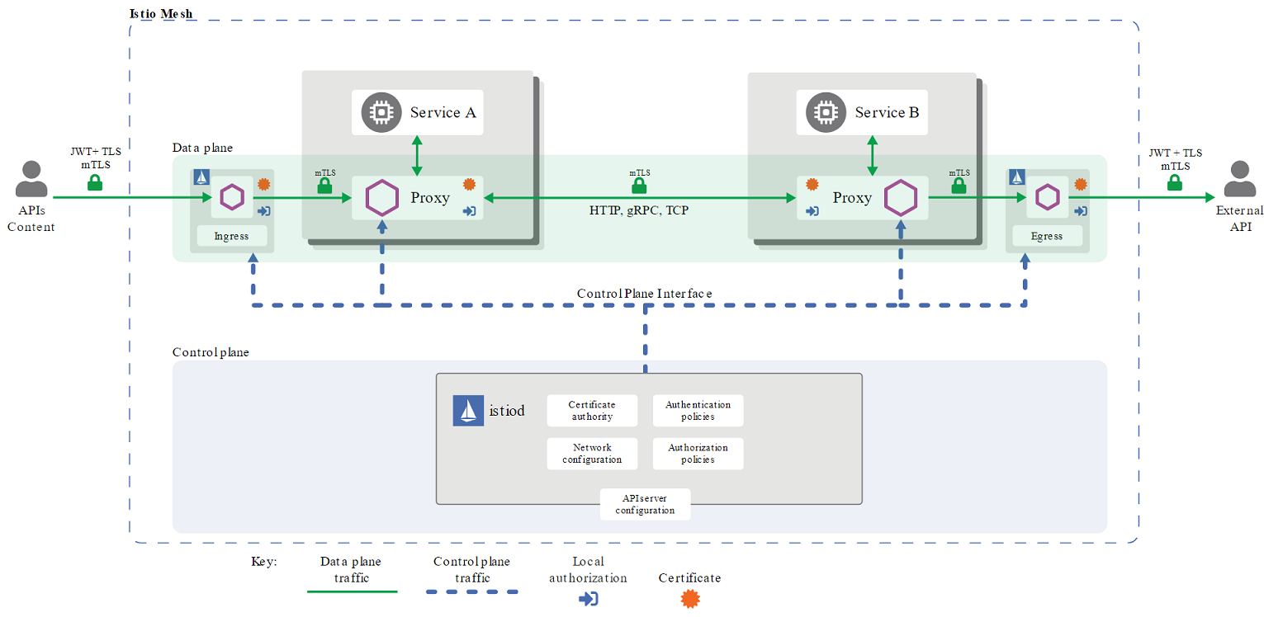
Istio Security Architecture Diagram

Slide 3
Istio Security Architecture
Istio implements Security without changes needed to application code and infrastructure. Istio completely shifts the burden of configuring security for each individual service away from developers. Istio security is implemented declaratively via yaml files external to the services implementation.
Istio owns a Certificate Authority (CA) for key and certificate management
The security API server communicates with the service proxies via:
authentication policies
authorization policies
secure naming information
The service Sidecars proxies work as Policy Enforcement Points (PEPs) to secure communication between services and between end users and services.
The Envoy proxy extensions manage telemetry and auditing

Slide 4
Istio Security components
Istio uses mutual transport layer security (TLS) to secure communication between services. TLS is the protocol designed to provide secure communication between apps, supports many algorithms to exchange keys and verify message integrity, and various ciphers to encrypt messages. mTLS validates the identify of both the client and the server services.
Istio supports two types of authentication:
Transport authentication, which provides service-to-service authentication with mutual TLS (mTLS)
Origin authentication (also known as end-user authentication), which provides client-to service authentication. Istio supports only JSON Web Tokens for origin authentication at this time.

Slide 5
Authentication Policies Modes
Secure Naming information and Authentication/Authorization Policies are used to verify that the service account presented in the server certificate is authorized to run the target service.
Authentication policies specify the mutual TLS mode Istio enforces on target workloads. The following modes are supported:
PERMISSIVE: Workloads accept both mutual TLS and plain text traffic. This mode is most useful during migrations when workloads without sidecar cannot use mutual TLS. Once workloads are migrated with sidecar injection, you should switch the mode to STRICT.
STRICT: Workloads only accept mutual TLS traffic.
DISABLE: Mutual TLS is disabled. From a security perspective, you shouldn’t use this mode unless you provide your own security solution.

Slide 6
Authorization Policies Modes
Authorization policies to the workloads enforce access control. For workloads without authorization policies applied, Istio doesn’t enforce access control allowing all requests.
Authorization policies support both ALLOW and DENY actions.

Slide 7
Istio Security components
The Citadel component in Istio manages the lifecycle of keys and certificates issued for services.
The Pilot component distributes the authentication policies and Secure Naming information to the Envoy proxies.
The Mixer component handles the authorization and auditing part of Istio security.

Slide 8
mTLS enablement
To enable a mutual TLS connection between services, we define Policy objects and DestinationRule objects.
A Policy object (also called an authentication policy) defines what kind of requests a service receives.
A DestinationRule object applies to the traffic that is destined for a target service. It tells the client services whether to send encrypted traffic to the target service or to send plain-text requests.
Policies and DestinationRules are defined in yaml files like we define yaml files to deploy containerized applications to kubernetes.

